Slide 1
Texas Hold’em Interface
Nathan Rylee
Dany Ing
Jonah Kaufman

Slide 2
Our interface
Example of a playing screen for a Texas Hold’em game
Shows 4 players and their hands, their purse, the deck, and the flop

Slide 3
Some features
Displays purse amount for each player
Cards flip when hovered over
Formatted to work on many resolutions, including mobile

Slide 4
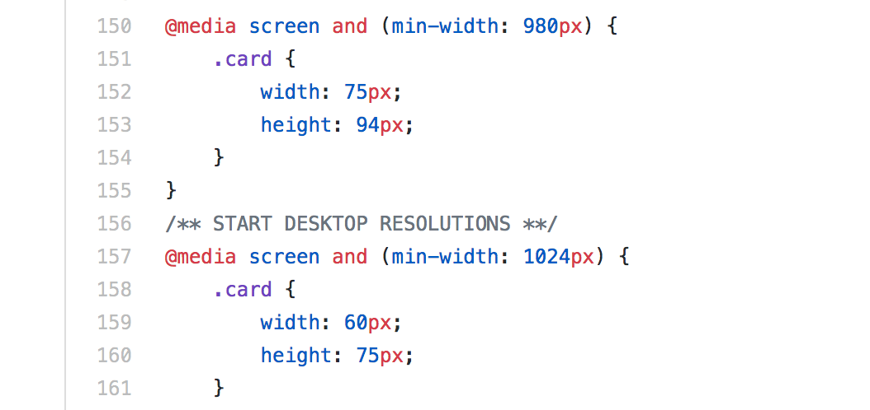
Mobile friendly / mobile first
This game is playable through the browser of both desktop and mobile platforms.
When designing for mobile, the base for the CSS accommodates the smallest size screen, as this is most likely the slowest device. Using the @media selector, we progressively target higher resolutions.
For mobile devices (anything below 1024px width screens), we use png files for the images. For desktops, we use svg files. This cuts down on data-transfer, but should only be used on more powerful desktop devices.

Slide 5
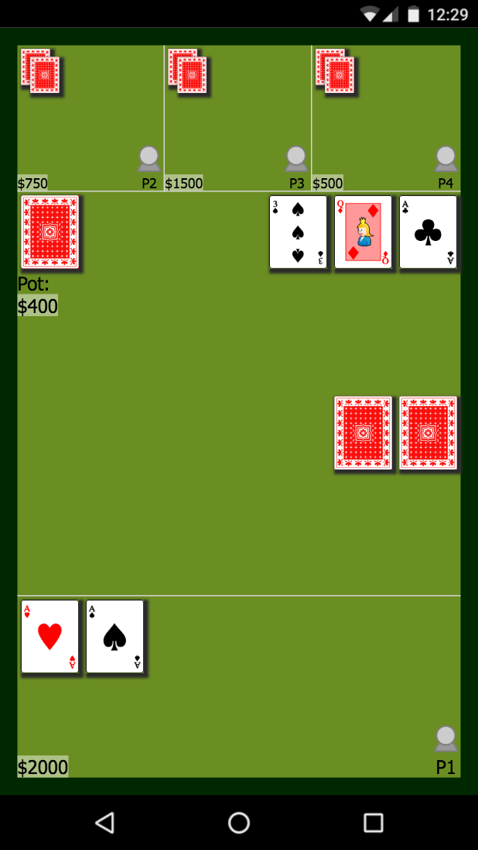
Mobile Design
In this design we placed the flop on a different line than the turn and river in order to accommodate a more vertical screen.

Slide 6
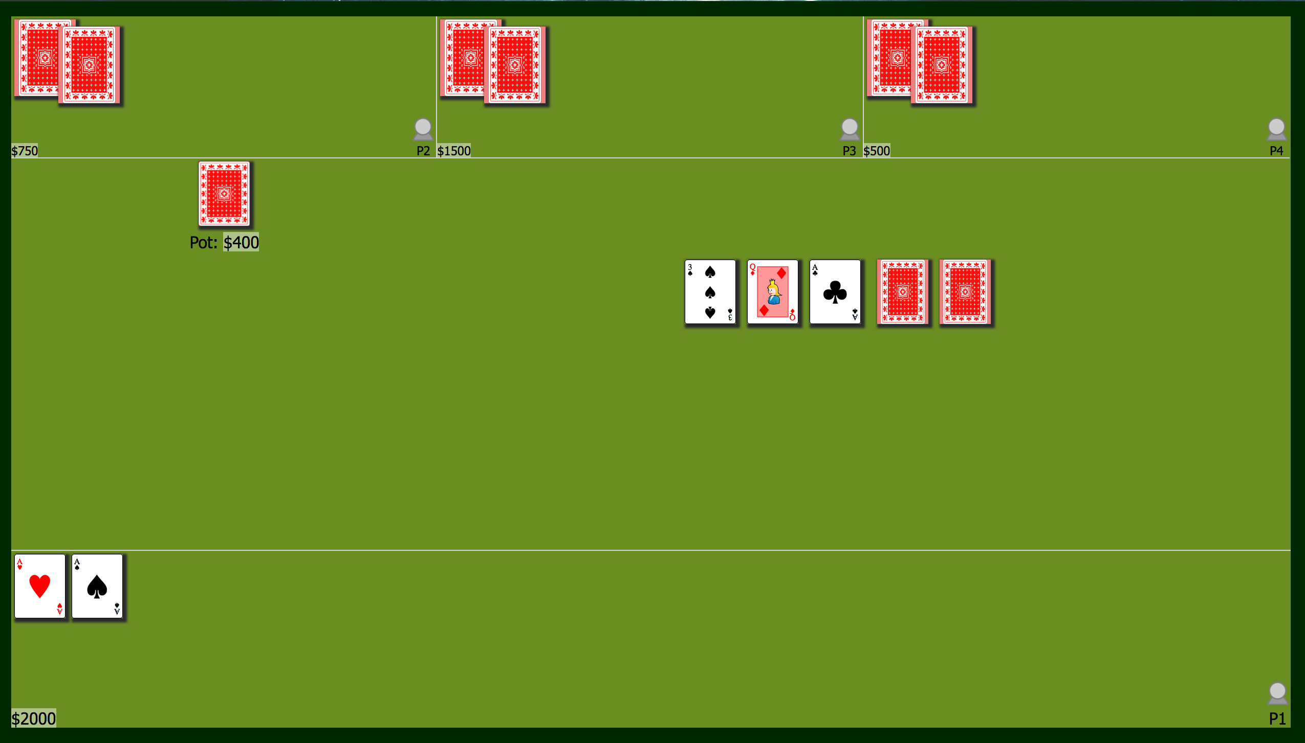
Desktop Design

